Slide 1
MICROCOMPUTER INPUT/OUTPUT
Md. Shafqat Talukder Rakin
Lecturer, Department of CSE,
United International University
Email id : shafqat@cse.uiu.ac.bd
Courtesy: Nasif M. Sir

Slide 2
Outline
Introduction
Programmed I/O
Interrupt I/O
Direct Memory Access (DMA)
Summary of I/O
2

Slide 3
Introduction
The technique of data transfer between a microcomputer and an external device is called input/output (I/O).
Peripherals are the I/O devices that connected to a microcomputer and provide an efficient means of communication between the microcomputer and the outside world.
3

Slide 4
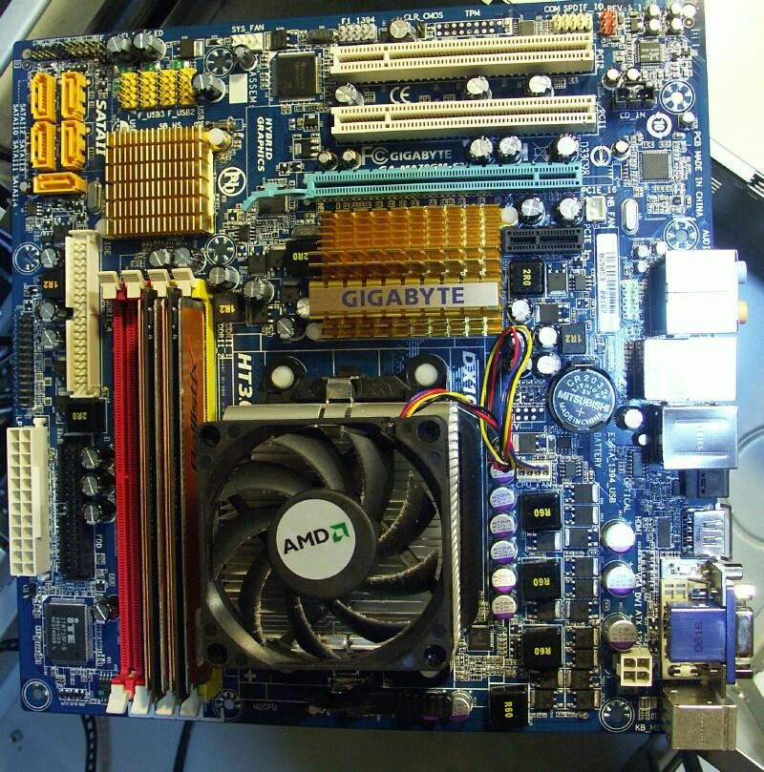
4

Slide 5
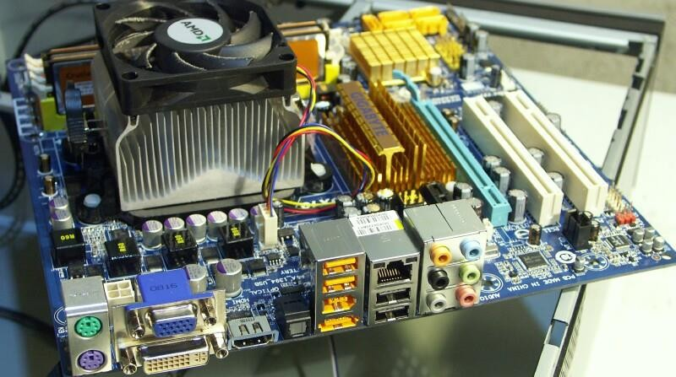
5

Slide 6
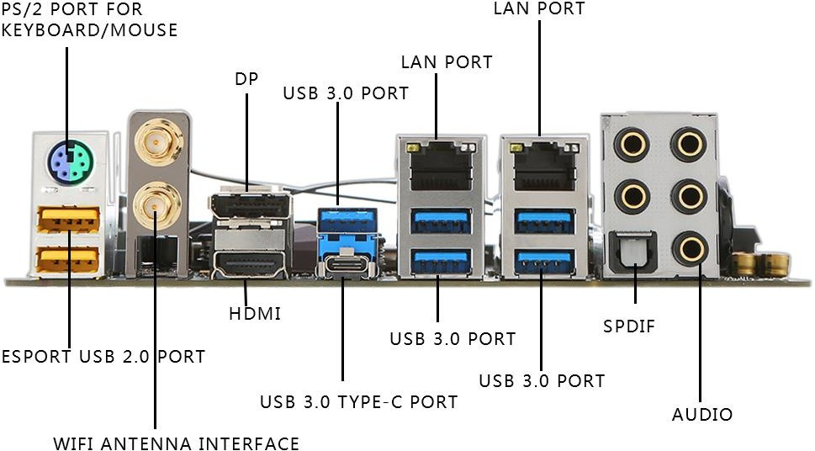

Slide 7
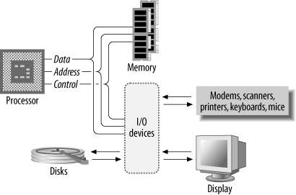
Figure. Basic computer system

Slide 8
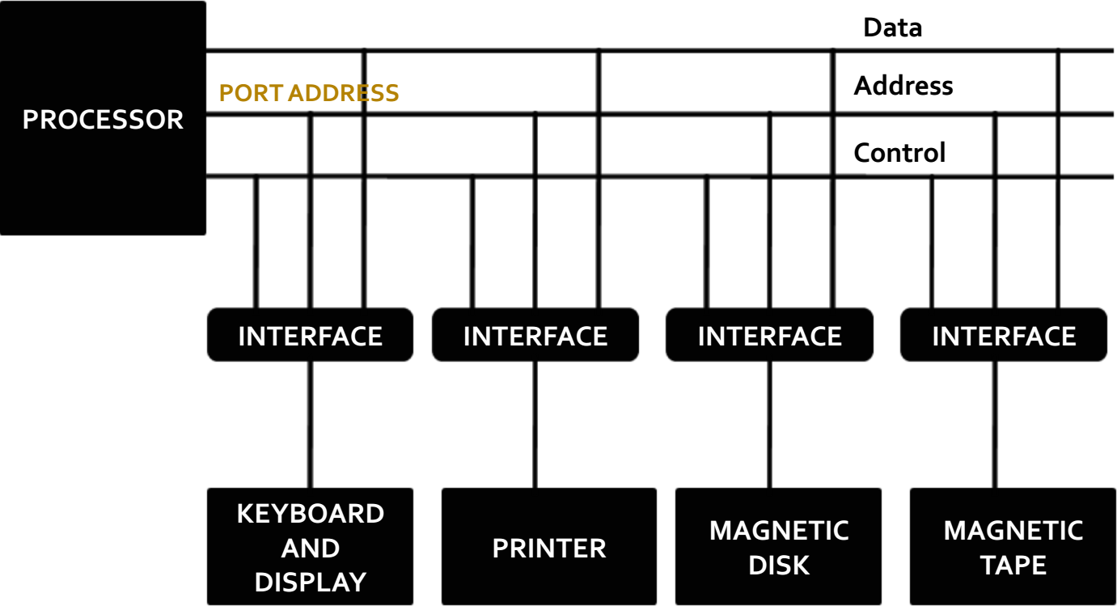

Slide 9
Introduction
The characteristics of I/O devices are normally different from those of a microcomputer like (speed and word length)
we need interface hardware circuitry between the microcomputer and I/O devices.
Interface hardware provide all input and output transfers between the microcomputer and peripherals.
9

Slide 10
Introduction
There are three ways of transferring data between a microcomputer and physical I/O devices:
Programmed I/O,
Interrupt driven I/O and
Direct memory access.
10

Slide 11
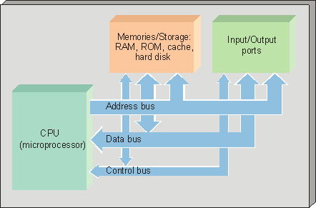
11

Slide 12
Introduction
There are three major types of data transfer between the microprocessor and I/O device.
Programmed I/O : In programmed I/O the data transfer is accomplished through an I/O port and controlled by software.
Interrupt driven I/O : In interrupt driven I/O, the I/O device will interrupt the processor, and initiate data transfer.
Direct memory access (DMA) : In DMA, the data transfer between memory and I/O can be performed by bypassing the microprocessor.

Slide 13
A. Programmed I/O
Programmed I/O, the microprocessor executes a program to perform all data transfers between the microcomputer and the external device.
The main characteristic of this type of I/O technique is that the external device carries out the functions dictated by the program inside the microcomputer memory.
13

Slide 14
I/O Port (1)
A microcomputer communicates with an external device via one or more registers called I/O ports using programmed I/O. I/O ports are usually of two types.
For one type, each bit in the port can be configured individually as either input or output.
For the other type, all bits in the port can be set up as all parallel input or parallel output
bits.
14

Slide 15
I/O Port (2)
I/O port is made up of group of 8 pins.
Each pin can be configured as either input pin or output pin.
If a pin is input pin, it accepts data from the device it is connected to.
If a pin is output pin, it sends the data to the device it is connected to.

Slide 16
I/O Port (3)
Each I/O port has at least two special-function registers:
A control register called a data-direction register (such as DDRA or DDRB) that controls whether
the port’s pins are configured as inputs or as
outputs.
A data register (such as PORTA or PORTB) that holds data traveling in or out through the port.

Slide 17
I/O Port (4)
Command or data-direction register
Determines the direction of individual pins of ports.
If the bit of the DDR is 1 then the corresponding pin of the port is configured as output pin.
If the bit of the DDR is 0 then the corresponding pin of the port is configured as input pin.

Slide 18
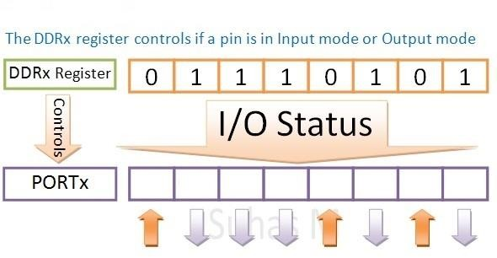
I/O Port (4)

Slide 19
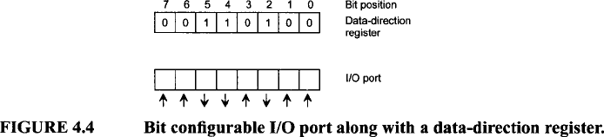
A. Programmed I/O
As an example, if an 8-bit data-direction register contains 34H (34 Hex), then which pin’s of the Port is set as Input and output.

Slide 20
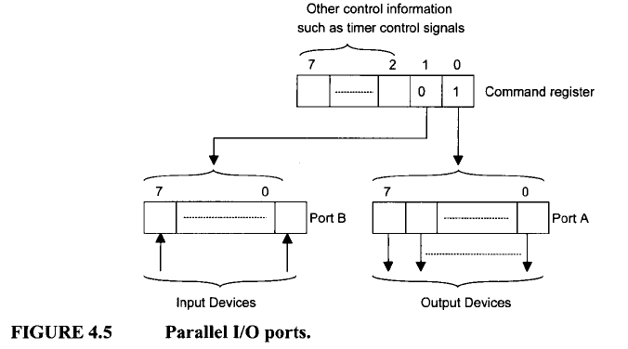
A. Programmed I/O
For parallel I/O, there is only one data directional register, known as the command register for all ports. A particular bit in the common register configures all bits in the port as either inputs or outputs. Programmable Peripheral Interface uses parallel I/O for configuration.

Slide 21
A. Programmed I/O
I/O ports are addressed using two techniques.
Standard I/O
Memory-mapped I/O

Slide 22
I. Standard I/O
Two separate address spaces are used – one for memory location and other for I/O devices.
The I/O devices are provided dedicated address space.
Hence, there are two separate control lines for memory and I/O transfer.
I/O read and I/O write lines for I/O transfer
Memory Write and Memory Read for memory transfer

Slide 23
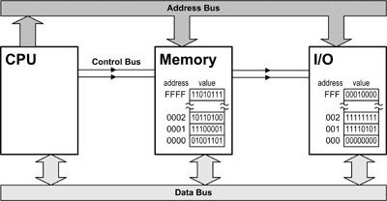
Standard I/O

Slide 24
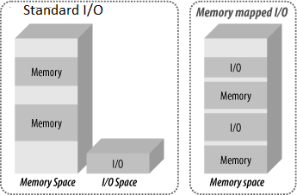

Slide 25
I. Standard I/O
Standard I/O or port I/O (called isolated I/O by Intel) uses an output control pin such as the M/ 𝐼𝑂 pin to distinguish between I/O and memory.
M/ 𝐼𝑂 pin= High;
The processor outputs a High to indicate that a memory operation is going on.
M/ 𝐼𝑂 pin = Low;
The processor outputs a Low to indicate that a I/O operation is going on.

Slide 26
Standard I/O
Memory oriented instruction
LDA 3000H (content of memory location 3000h is copied in accumulator)
STA 3000H (the content of accumulator is stored into the memory location 3000h)

Slide 27
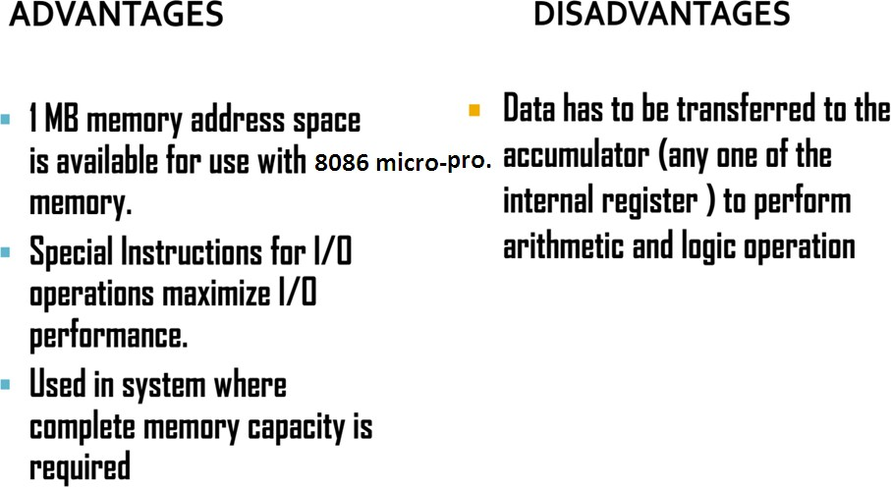
Standard I/O

Slide 28
II. Memory-mapped I/O
In memory mapped I/O scheme, CPU addresses an I/O device just like a memory location.
In this scheme only single address space is used by CPU. Some addresses of the address space are assigned to memory location and other are assigned to I/O devices.
The instructions used to manipulate the memory can be used for I/O devices.

Slide 29
II. Memory-mapped I/O
In memory-mapped I/O, the microprocessor does not use the M / 𝐼𝑂 control pin. Instead, the microprocessor uses an unused address pin to distinguish between memory and I/O.
In memory mapped I/O, the most significant bit (msb) of the address can be used to distinguished between I/O and memory.
Msb=1; I/O port selected
Msb=0; memory location is selected
This reduces the micro-processor memory by 50%.

Slide 31
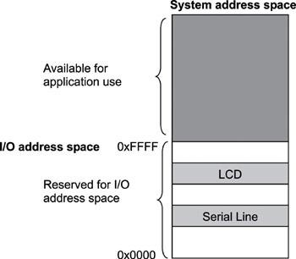

Slide 32
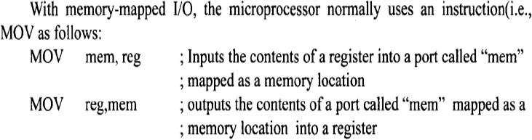
Memory mapped I/O
Printer device
Keyboard device
32

Slide 33
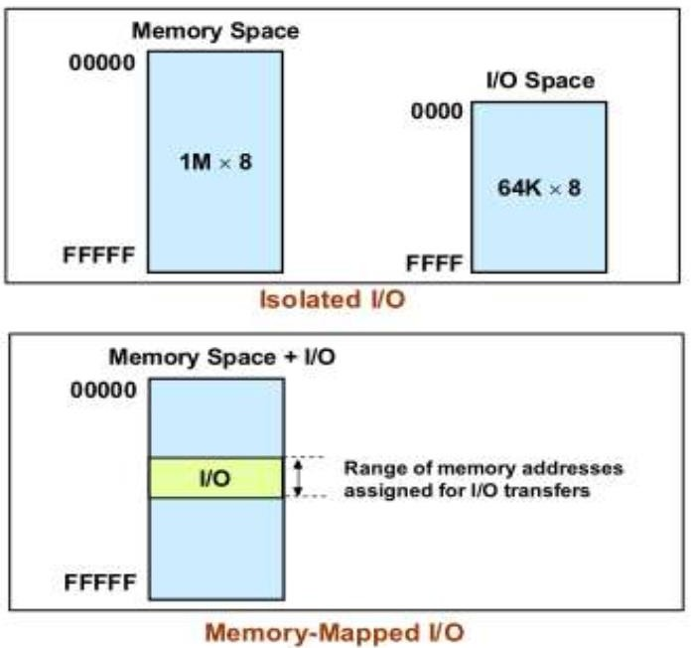

Slide 34
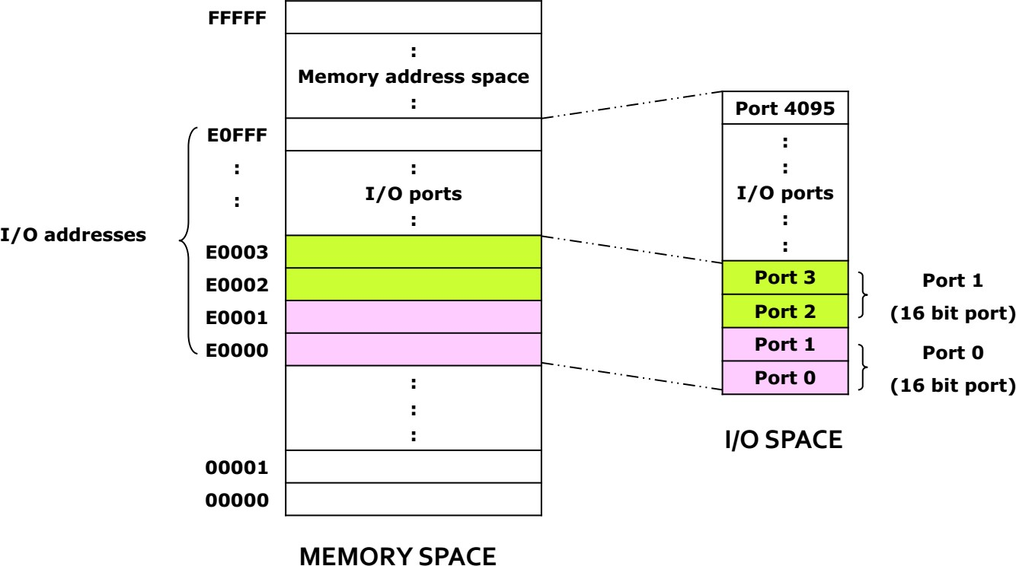
Memory mapped I/O

Slide 35
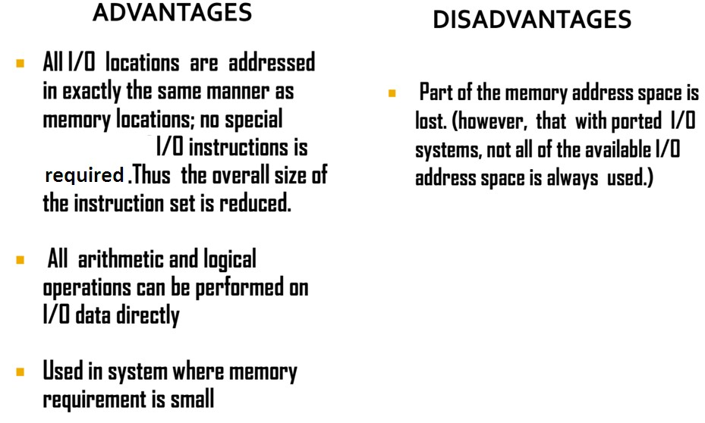
Memory mapped I/O

Slide 36
2. Interrupt driven I/O
Interrupt I/O, an external device can force the microprocessor to stop executing the current program temporarily so that it can execute another program known as an interrupt service routine.
After completing this program, a return from interrupt instruction can be executed at the end of the service routine to return control at the right place in the main program.

Slide 37
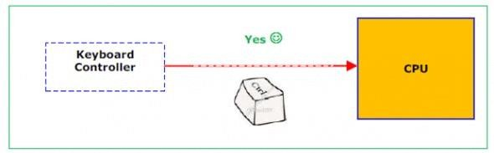
2. Interrupt driven I/O
The CPU executes other program, as soon as a key is pressed, the Keyboard generates an interrupt. The CPU will response to the interrupt – read the data. After that returns to the original program.

Slide 38
2. Interrupt driven I/O
Interrupts are useful when interfacing I/O devices at relatively low data transfer rates, such as keyboard inputs.
Interrupt processing allows the processor to execute other software while the keyboard operator is thinking about what to type next.
38

Slide 39
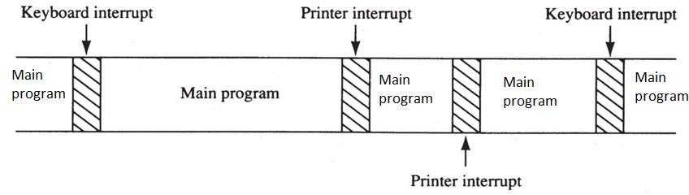
Time
Figure: A time line that indicates interrupt usage in a typical system.
A time line shows typing on a keyboard,
a printer removing data from memory, and main program execution.
The keyboard interrupt service procedure, called by the keyboard interrupt, and the printer interrupt service procedure called by the printer interrupt. Each interrupt take little time to execute.

Slide 40
2. Interrupt driven I/O
Interrupt driven I/O is a device-initiated I/O transfer. The external device is connected to a pin called the interrupt (INT) pin on the microprocessor chip.

Slide 41
2. Interrupt I/O
There are typically two types of interrupts:
External interrupts,
Internal interrupts,

Slide 42
2. Interrupt I/O
External interrupts can be divided further into two types: maskable and non-maskable.
Maskable interrupt can be enabled or disabled by instructions.
The examples of maskable interrupt are: mouseclick, keystroke on keyboard etc.

Slide 43
2. Interrupt I/O
Non-Maskable interrupt cannot be enabled or disabled by instructions.
A non-maskable interrupt is typically used as a power failure interrupt.
Micro-processor normally use +5V which is transformed from 110V AC. If the voltage drops below 90V then +5V cannot be maintained. However, it will take a few milliseconds to drop power below 90V. In these few millisecond, the power failure-sensing circuit can interrupt the micro-processor. An interrupt service routine can be written to store critical data in non- volatile memory.

Slide 44
2. Interrupt I/O
Internal interrupts, are activated internally by exceptional conditions such as overflow, division by zero, or execution of an illegal op-code.

Slide 45
C. Direct memory access (DMA)
Direct memory access (DMA) is a type of I/O technique in which data can be transferred between microcomputer memory and an external device such as the hard disk, without microprocessor involvement.
A special chip called the DMA controller chip 8237 is typically used with the microprocessor for transferring data using DMA.

Slide 46
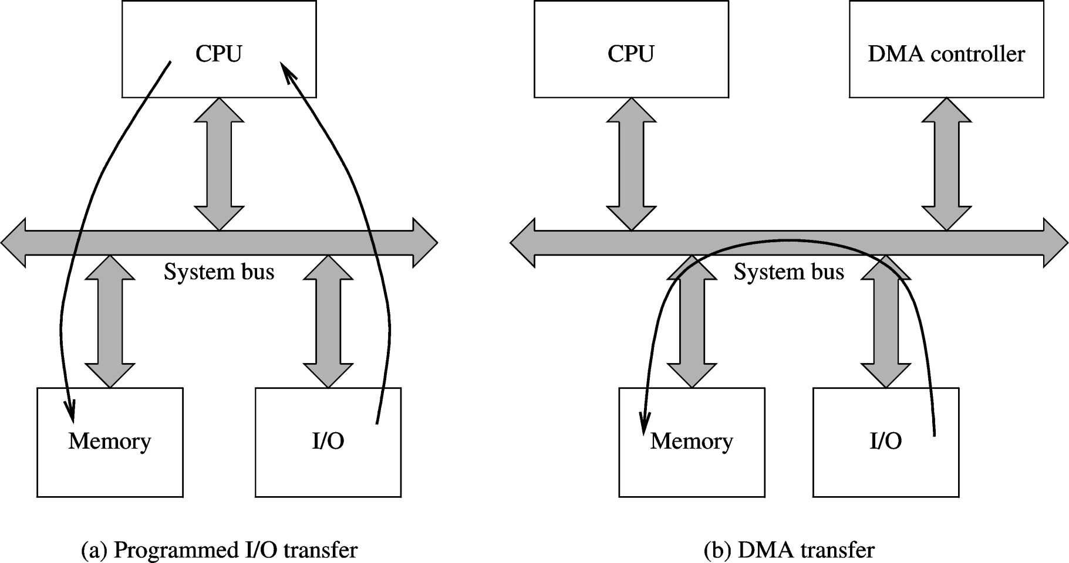
C. Direct Memory Access (DMA)

Slide 47
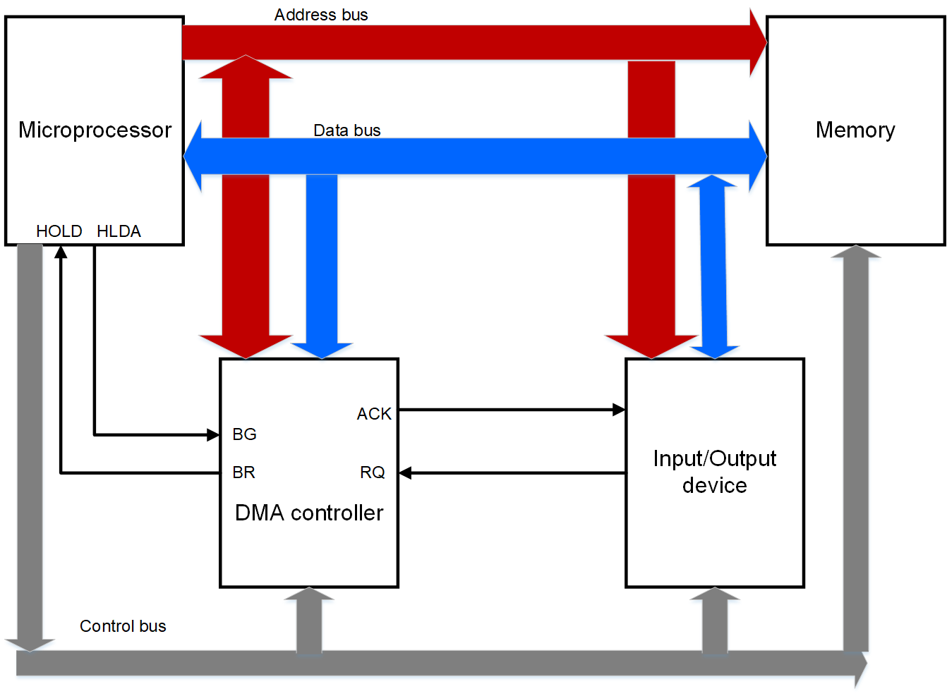
C. Direct Memory Access (DMA)
Figure: Micro-computer interfaced with DMA controller chip 8237
47

Slide 48
C. Direct Memory Access (DMA)
DMA operation
The I/O devices request DMA operation via the DMA request line of the controller chip.
The controller chip activates the microprocessor HOLD pin, requesting the microprocessor to release the bus.
The microprocessor sends HLDA (hold acknowledge) back to the DMA controller, indicating that the bus is disabled. The DMA controller places the memory address on the address bus and sends a DMA acknowledge to the peripheral device.
The DMA controller completes the DMA transfer and release the buses.

Slide 49
C. Direct Memory Access (DMA)
The DMA controller includes several registers :
The DMA Address Register contains the memory address to be used in the data transfer.
The DMA Count Register, also called Word Count Register, contains the no. of bytes of data to be transferred.
The DMA Control Register accepts commands from the CPU.

Slide 50
C. Direct Memory Access (DMA)
Modes vary by how the DMA controller determines when to transfer data.
BURST mode
CYCLE STEALING Mode
TRANSPARENT Mode

Slide 51
C. Direct Memory Access (DMA)
BURST mode
DMA controller obtains access to the system buses using BR (Bus Request) & BG (Bus Grant) signals.
An entire block of data is transferred in one contiguous sequence. Once the DMA controller is granted access to the system buses by the CPU, it transfers all bytes of data in the memory data block before releasing control of the system buses back to the CPU.
This mode is useful for loading programs or data files into memory, but it make the micro-processor CPU inactive for relatively long periods of time.

Slide 52
C. Direct Memory Access (DMA)
CYCLE STEALING Mode
Viable alternative for systems in which the micro- processor CPU should not be disabled for the length of time needed for Burst transfer modes.
DMA controller obtains access to the system buses using BR (Bus Request) & BG (Bus Grant) signals.
The DMA controller, after transferring one byte of data, releases control of the system buses by sending a bus grant signal (BG) through the control bus, and lets the CPU process an instruction and then requests access to the bus by sending the bus request signal through the control bus and then transfers another byte of data.

Slide 53
C. Direct Memory Access (DMA)
CYCLE STEALING Mode
By continually obtaining and releasing control of the system buses, the DMA controller essentially interleaves (one-after-another) instruction & data transfers. The micro-processor CPU processes an instruction, then the DMA controller transfers a data value, and so on.
The data block is not transferred as quickly as in burst mode, but the CPU is not idled for as long as in that mode.

Slide 54
C. Direct Memory Access (DMA)
TRANSPARENT Mode
The DMA controller only transfers data when the micro-processor CPU is performing operations that do not use the system buses.
This is the slowest mode to transfer a block of data, yet it is also the most efficient in terms of overall system performance, while the disadvantage is that the hardware needs to determine when the CPU is not using the system buses, which can be complex.

Slide 55
Problem
Transfer of bus control in either direction, from processor to device or vice-versa, takes 250 ns. One of the IO device has data transfer rate of 75 KB/sec and employs DMA.
(a) Suppose we employ DMA in a burst mode. How long does it take to transfer a block of 256 bytes?
b) Data are transferred one byte at a time. Calculate the same for cycle stealing mode

Slide 56
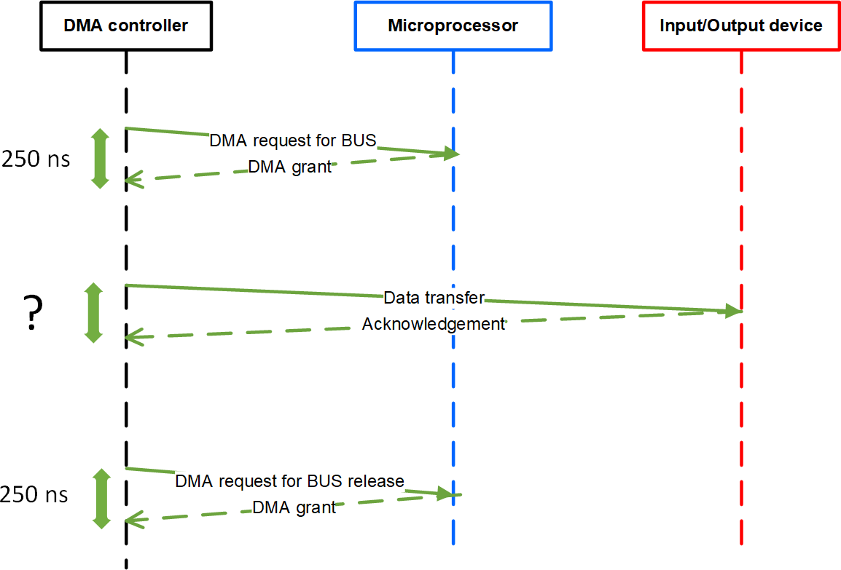
Figure : Sequence diagram showing DMA burst mode

Slide 57
1. Burst Mode (Block Mode)
That is, the DMA interface gains bus mastership prior to the start of block transfer and maintains control of the bus until the whole block is transferred.
Total time = (Transfer of bus control from Processor to DMA)
+ (Time taken to transfer 250 Bytes from DMA to mem) + (Finally transferring back bus control from DMA to Processor)
Transfer of bus control from Processor to DMA = 250ns
transferring back bus control from DMA to Processor= 250ns
Time taken to transfer 250 Bytes from DMA to mem = 256/(75*1024) seconds = 3333333.33 ns
Total = 250 + 3333333.33 +250
=3333833.33 ns

Slide 58
2.Cycle Stealing Mode -
Let x=Time of Transfer of bus control from Processor to DMA
Let y=Transfer time of 1 Byte(as Memory is Byte addressable) from DMA to Mem.
Let z=Time of Transfer of bus control from DMA to Processor
So the time sequence will be = xyz, xyz, xyz......so on until all 256 Bytes are transferred.
1 xyz transfers 1 Byte, total time for 1 xyz= 250ns + 13020.83ns
(time to transfer 1 Byte) +250ns.
1 xyz takes a total of = 13520.83ns
so 256 Bytes transfer will take = 13520.83ns * 256 = 3461333.33ns or 3461333330ps

Slide 59
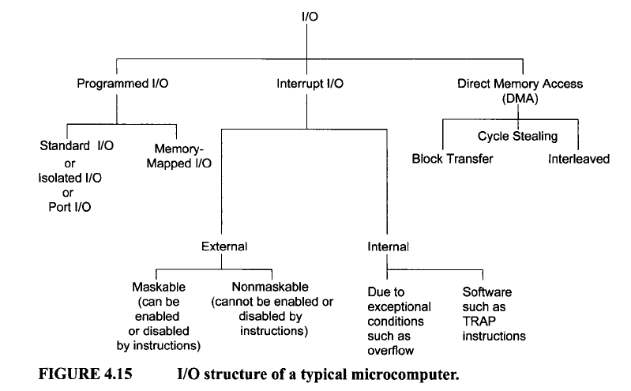
Summary of I / O
59

Slide 60
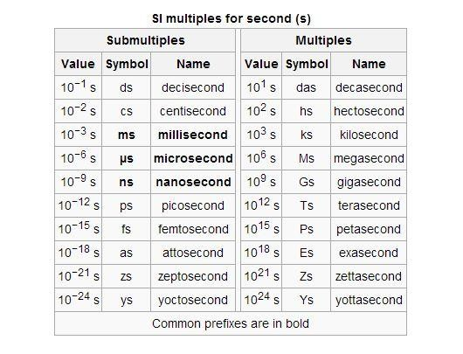
60

Slide 61
Thank You

